Slide 1
Is it Science or Science Fiction?!?
A Natural Language Processing analysis and classification of the two SubReddits, Ask Science and Ask Science Fiction
Jonathan Beatty

Slide 2
What are we asking?
Can we build a model that will predict, to at least a 95% accuracy, if a title comes from the Sub-Reddits Ask Science and Ask Science Fiction?
Why did I choose these categories?

Slide 3
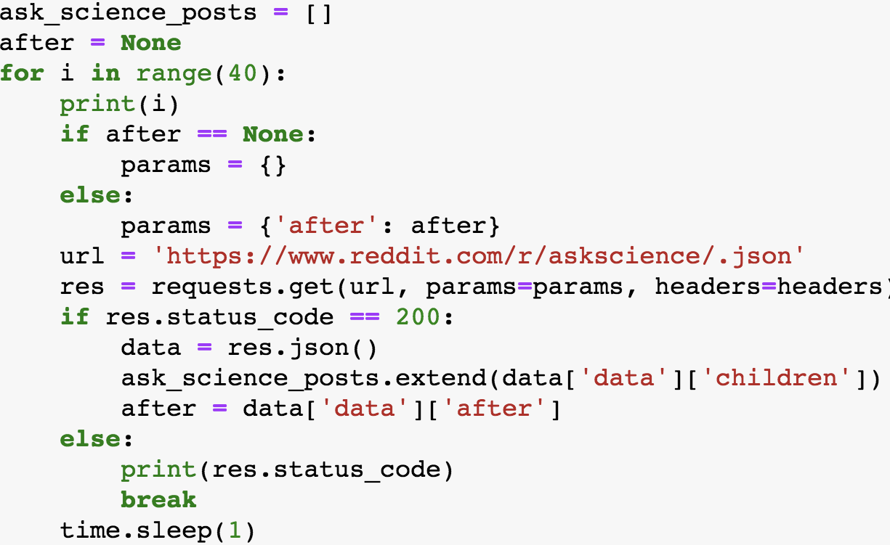
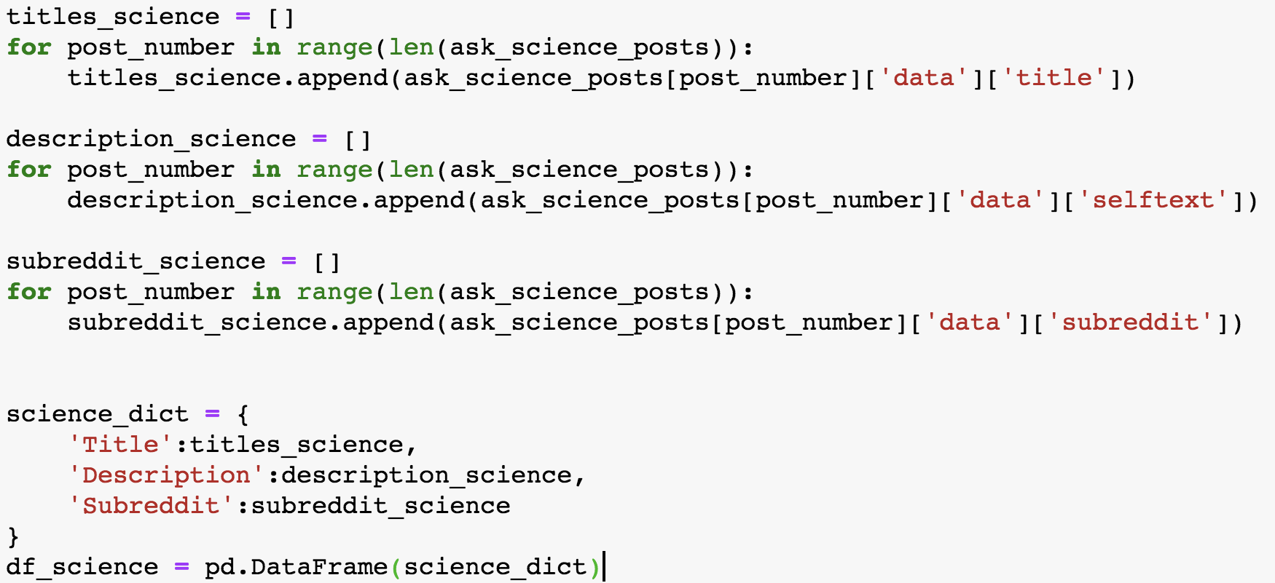
Collecting our Data
Scraped 1000 posts from each category using the for loop below.
Stored all of the titles, descriptions and subreddit names into a dictionary which I cast into a pandas Dataframe.

Slide 4
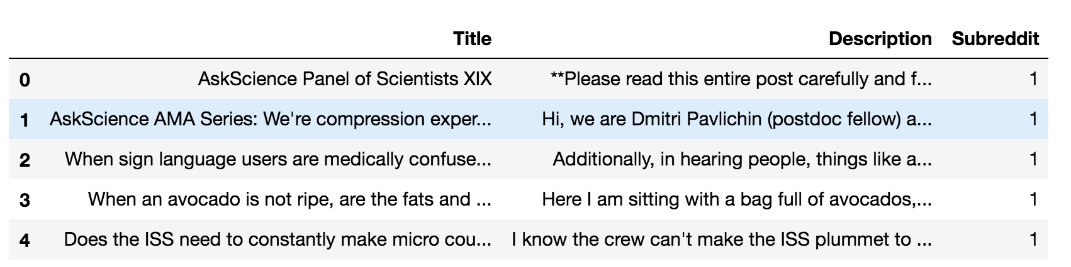
Collecting our Data cont.
After collecting 1000 posts from each reddit and making a dataframe for each we will concat them together and drop all duplicate titles to have a clean dataframe to start my analysis.

Slide 5
Questions to answer about or data
Are there words that could help as stop words?
Are our classes balanced?
Do we have enough information?
Are there any non numeric indicators that we could use in modeling?

Slide 6
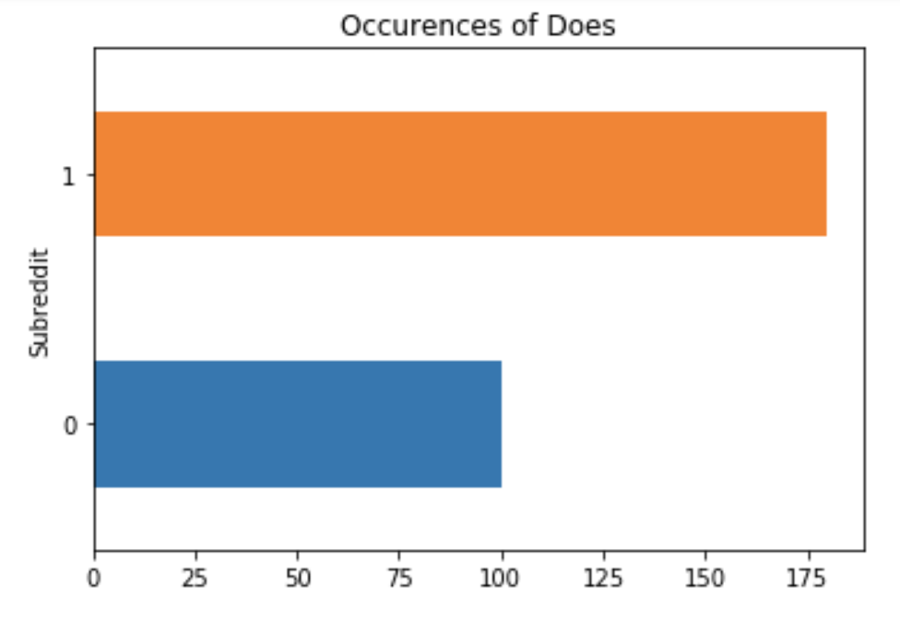
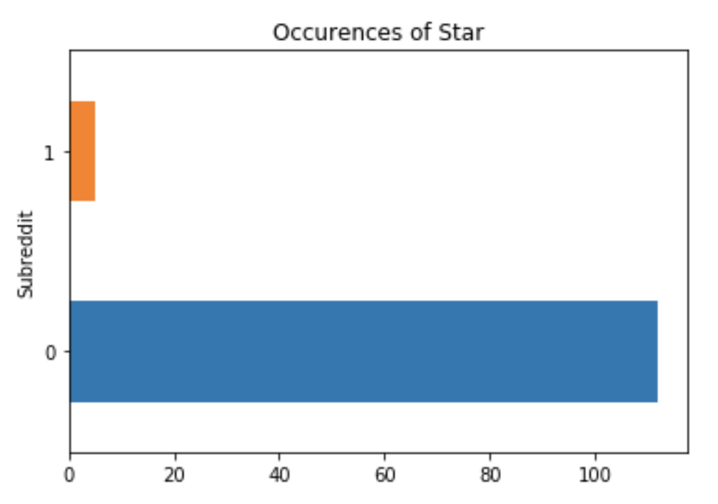
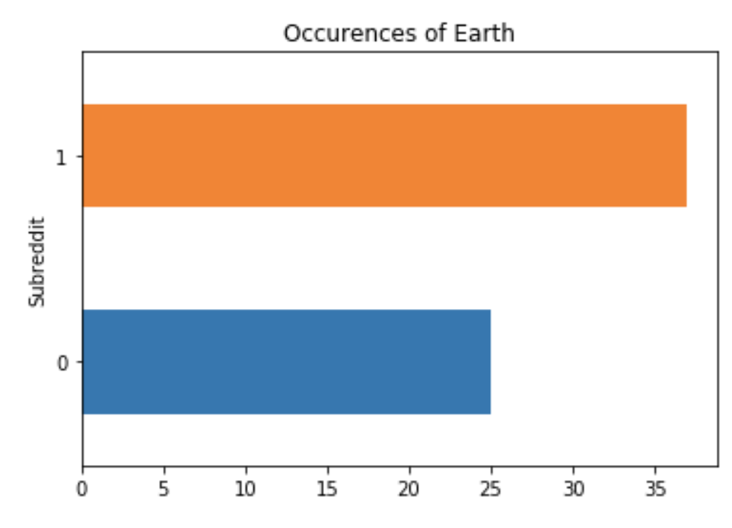
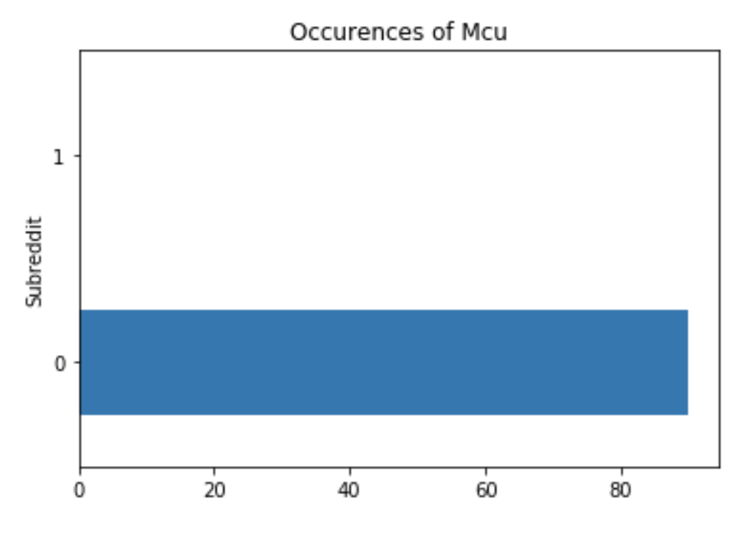
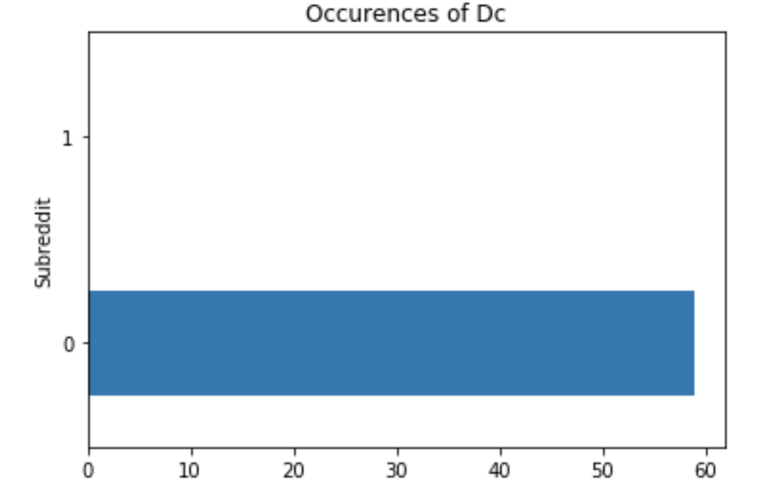
Top 5 most used words according to subreddit

Slide 7
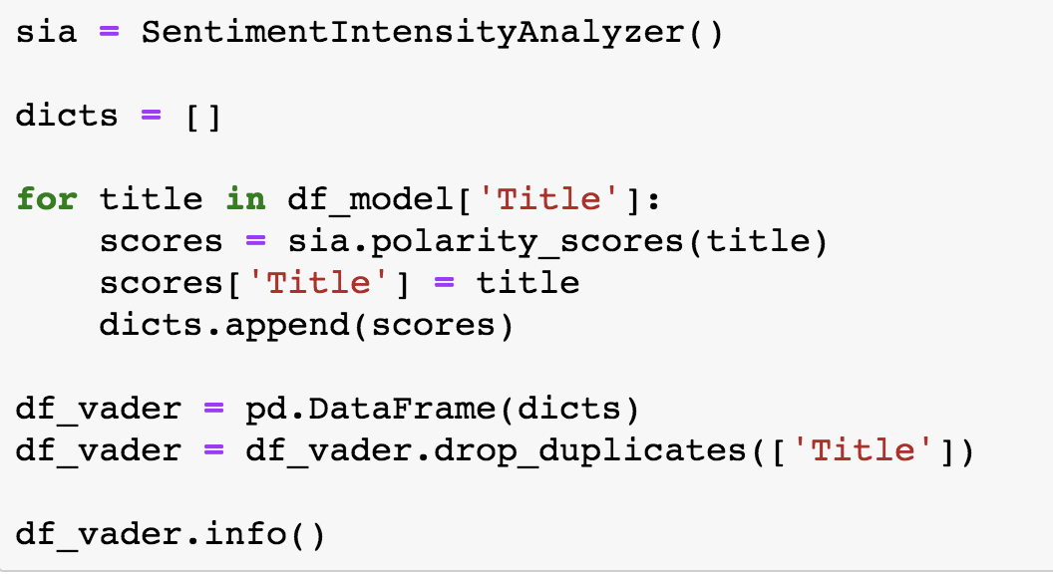
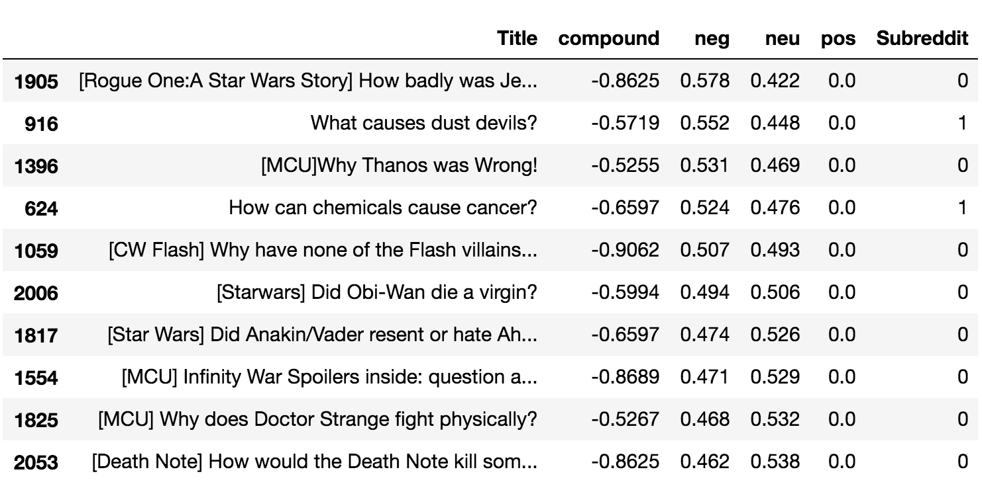
Send in VADER!
Below I ran a VADER Sentiment Analysis, why did I do this?
Below is the Top 10 “Negative” titles for our model.

Slide 8
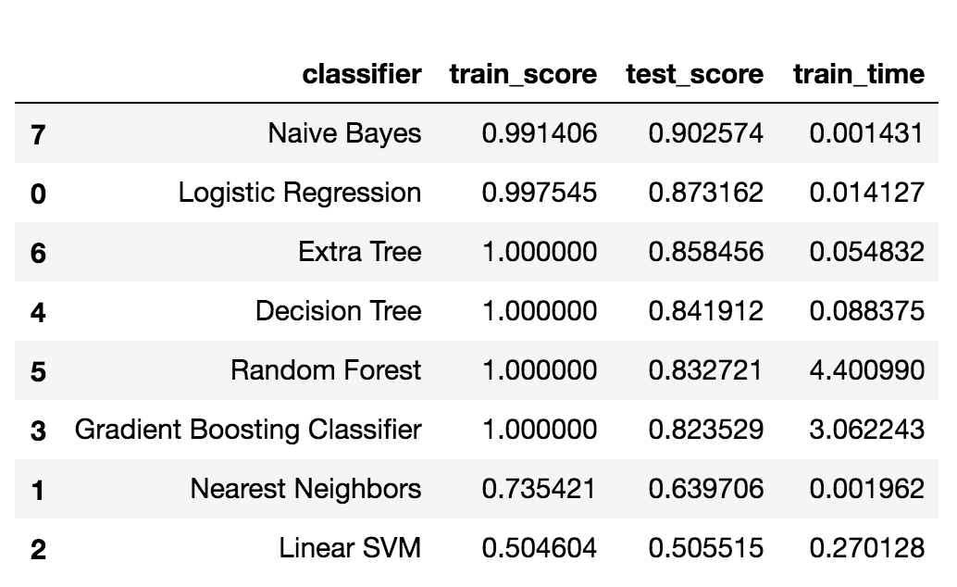
Getting a baseline look..
In the picture below I have a data frame of scores from some of the top classifier models on our training and test data sets. This was a beginning guide to start fitting models into a pipeline and gridsearch to fine tune parameters.

Slide 9
Top takeaways from second round of modeling:
Count vectorizing is the best vectorizing method in all classification models.
Stop Words = None is the best parameter for stop words in CV
Multinomial NB continues to outperform other models with gridsearch parameter tuning
Best score was 91.17 from MNB on the testing data
Other top performing models:
Logistic regression/CV- 90.4
BernoulliNB/CV - 89.8
Support Vector Machine/CV - 89.3

Slide 10
Notable under-producing models
Random Forest/CV- 85.2
AdaBoosting/CV- 87.5
Gradient Boosting/CV- 84.7
Bagging/CV - 82.7
BernoulliNB/Hash Vectorizer- 50.4?!?!
I was wondering if anyone has any thoughts as to why this model was turning out so poorly?

Slide 11
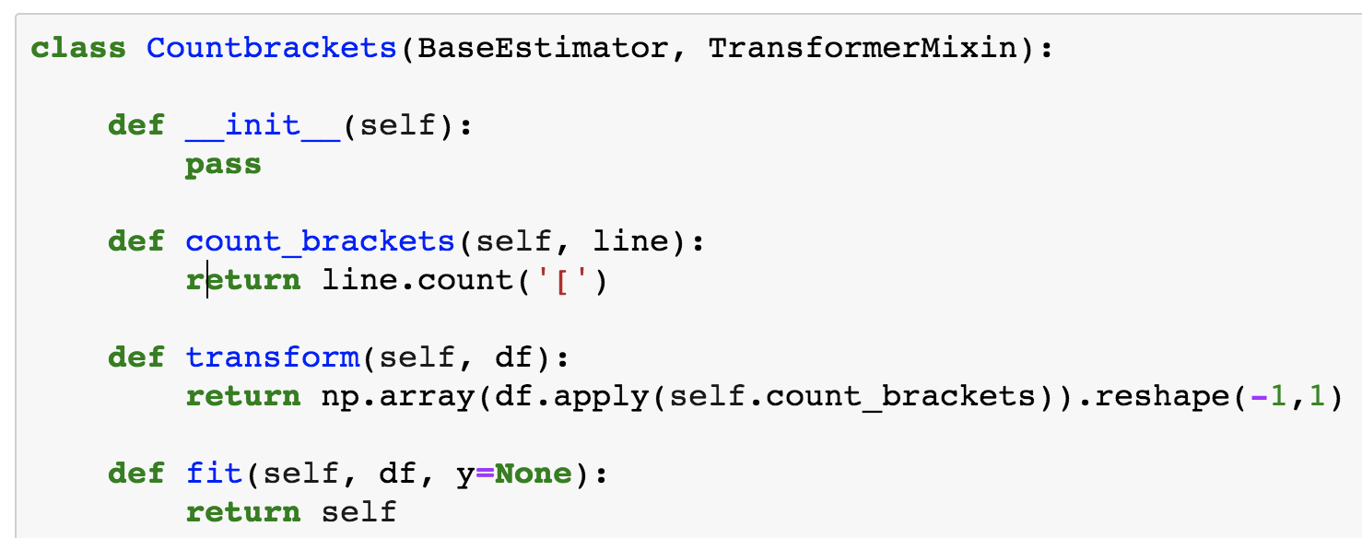
Brackets, Brackets everywhere and not a thought to think
When trying to figure out the next steps to increasing the accuracy of my model I received inspiration from a higher power…...Caroline!!
We created a custom classifier to count brackets, since the brackets only appear in the Ask Science Fiction reddit to classify which universe the question is coming from.

Slide 12
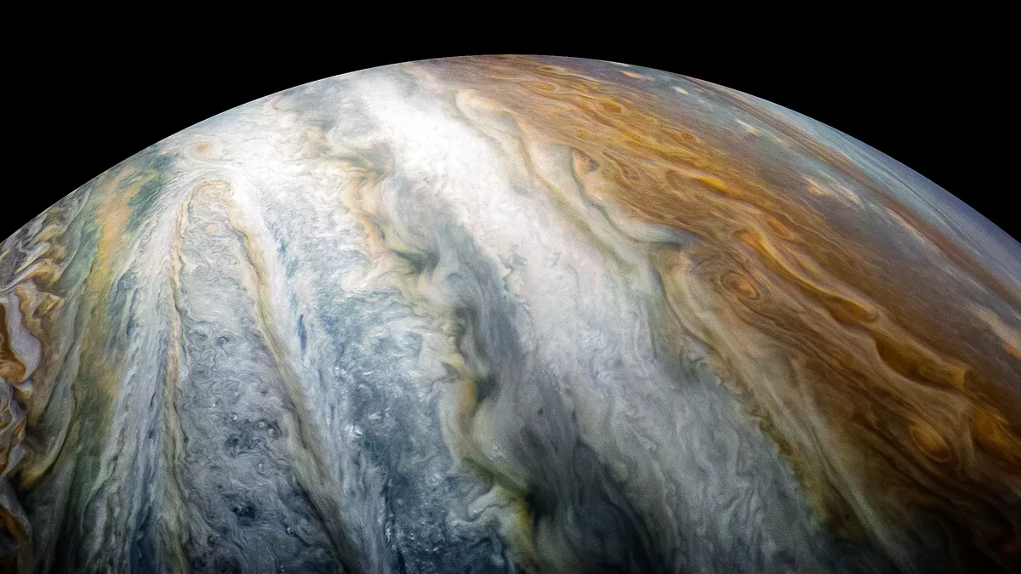
Reddit’s Top Models
TO JUPYTER!!
FOR MODELING!

Slide 13
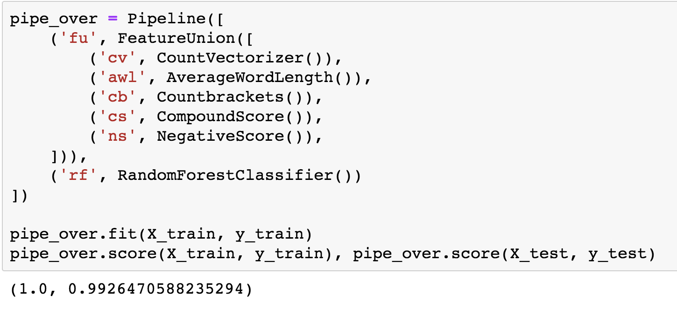
The winning model

Slide 14
Final Thoughts
1. When I added all of the classifiers from the vader sentiment analysis it seemed to lower the score. The best combination I found was the model above with just the negative and compound scores from VADER.
2. The largest jump occurred when using a custom classifier to use brackets as an indicator for the model. When we used that in our model it took our score from roughly 90% to 97%. It was at that point that we added the vader analysis numbers to increase our score to the one above.
3. Its Random Forest! That's very surprising because RF was never the best performing model until we introduced the count brackets classifier. I used it to model my vader since it beat all other top models in the area above.

